Slide 1
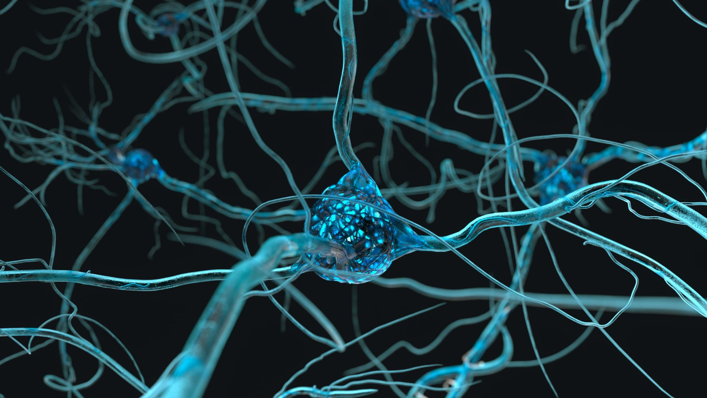
Intriguing Properties of Neural Networks: Revisited
Rishabh Agarwal, Tanmay Khule and Ehsan Ur Rahman Mohammed
ragrawa9@uwo.ca, tkhule@uwo.ca and mrahm326@uwo.ca

Slide 2
Agenda
Introduction and Problem Statement
Literature Review (Situating our Research)
Methodology
Intuition
Results and Discussion
Conclusion and Future Scope
References

Slide 3
Problem Statement
INTRODUCTION
WHAT IS ?
Transfer learning
Adversarial attacks
Adversarial robustness
1. Evaluating adversarial robustness of scratch & fine-tuned models
2. Performing analysis to understand their “unstability”

Slide 4
Related Works
[1] Intriguing Properties of Neural Networks – Szegedy et. al.
[2] An Empirical Evaluation of Adversarial Robustness under Transfer Learning – Davchev et. al.
[3,4, and 5] are couple of research studies that aim to improve adversarial robustness in transfer learning settings

Slide 5
Methodology Experimental Setup and Details
Two models – ResNet50 architecture
Pre-trained fine-tuned model
Model trained from scratch
Dataset: CIFAR10
Attack: Projected Gradient Decent attack & Gaussian Noise attack
Spectral analysis
Feature maps
Weight

Slide 6
Intuition
Components of the methodology
Calculation of distortion between original and Adversarial (PGD) & original and Gaussian attacks for both the models
Reasoning behind them
Based on [1], the average distortion measure provides a good indication of adversarial robustness and the vulnerability of the network to adversarial (and Gaussian) noise

Slide 7
Intuition
Components of the methodology
Spectral analysis of “unstability”
Reasoning behind them
Based on [1] the upper Lipschitz constant is a good indicator of the “unstability” of a network

Slide 8

Intuition contd…
(i)
(ii)
(iii)
(iv)
(v)

Slide 9

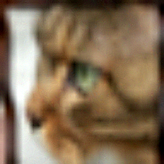


Attack Example
PGD
(a)
Original
Gaussian
(b)

Slide 10
Results and Discussion
Model Name | Attack | Average Distortion | Upper Lipschitz Constant | Clean Accuracy
ModelFineTune | Gaussian Attack | 33.70 | 1.33 | 93.75
ModelFineTune | PGD | 12.29 | 2.51 | 93.75
ModelScratch | Gaussian Attack | 124.21 | 1.38 | 88.54
ModelScratch | PGD | 6.08 | 3.81 | 88.54

Slide 11
Results and Discussion
What do our results mean?
Does the work done in [1] still hold for bigger models?
If yes, does it hold for the pre-trained model?
Does pre-training help to boost adversarial robustness?
Is there a correlation between “unstability” and average distortion values? In both cases?

Slide 12
Conclusion and Future Scope
Conclusion
Future Scope
We are waiting for our final results
Evaluating adversarial robustness to stronger SoTA attacks
Evaluating other transfer learning methods
Comparing average distortion with other kinds of common corruptions besides Gaussian noise
Theoretical frameworks

Slide 13

References

Slide 14

Thank you!
ragrawa9@uwo.ca
tkhule@uwo.ca
mrahm326@uwo.ca

